Slide 1
Inventory Management System Project
Onur Hassan

Slide 2
The MVP
To create an automated inventory management system
The java application should have CRUD functionality with the database
User CLI interaction

Slide 3

User Stories

Slide 4
SQL Schema
CREATE DATABASE IF NOT EXISTS IMSDB;
USE IMSDB;
CREATE TABLE Items(
item_id int not null,
item_name varchar(50),
value_ double not null,
PRIMARY KEY(item_id));
CREATE TABLE Customers(
customer_id int NOT NULL AUTO_INCREMENT,
first_name varchar(20) NOT NULL,
last_name varchar(20) not null,
PRIMARY KEY (customer_id)
);
CREATE TABLE Orders(
order_id int NOT NULL AUTO_INCREMENT,
customer_id int NOT NULL,
item_id int NOT NULL,
PRIMARY KEY (order_id),
FOREIGN KEY (customer_id) REFERENCES Customers(customer_id),
FOREIGN KEY (item_id) REFERENCES Items(item_id)
);
SHOW DATABASES

Slide 5
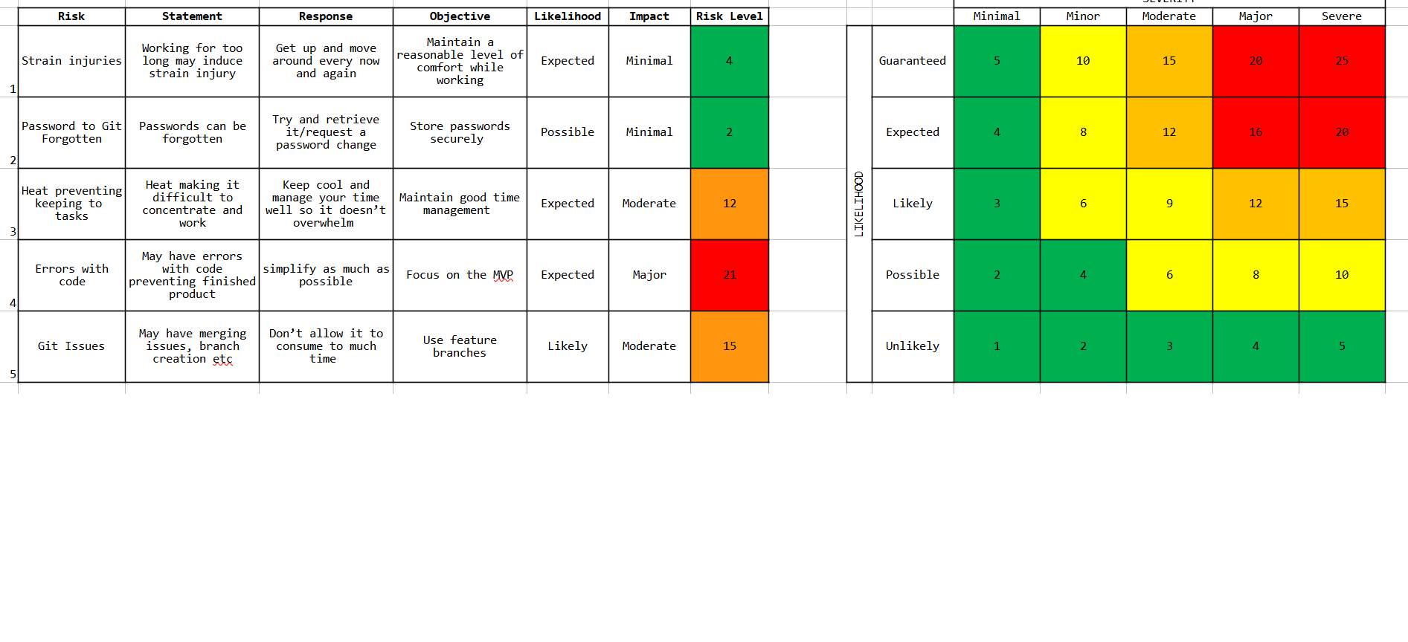
Risk Assessment

Slide 6
Demo

Slide 7
Improvements that would have been favoured
80% coverage
Simplifying and not wasting time trying to make the app work with AWS
Planning the project better to end up with better time management
Having the database selection be fully functional
Use feature branches
Having a GUI

